Slide 1
Trials and Tribulations of Single-Page Applications Concentration on emberJS
03/23/2018
Disclosure: Views represented are those of the presenters and not necessarily State Farm.
Notes:
Andy

Slide 2
Agenda
Introductions
Overview
General Considerations
Working examples (emberJS)
Page title, language attribute, focus management with modal
Closing
Q&A
Notes:
Andy

Slide 3



Introductions
Andy Nelson
Digital A11y Specialist
State Farm Insurance
Mark Steadman
Software Developer
State Farm Insurance
CB Averitt
Senior Consultant
Deque Systems
Notes:
Andy

Slide 4
Overview: Single Page Applications
A web application that fits on a single page with dynamic actions without refreshing the page
Highly interactive applications leveraging client-side rendering techniques
Primarily driven by the proliferation of mobile devices
Notes:
Andy

Slide 5
General Considerations
Document & Heading Structure
Page/View Titles
Focus Management
Keyboard Navigation
Dynamically Added Content - Aria Live
Use Native HTML Tags (whenever possible)
If custom tags are created, ensure:
All necessary semantics are conveyed and managed (using ARIA; role, state, value, etc.)
Keyboard and touch functionality is added
Keyboard focus is added
Notes:
Andy
At this point, ask the audience if there are any other challenges or opportunities they have experienced

Slide 6
Document Structure
Navigation Challenge
Semantic document structure, which includes proper heading structure
A well-structured webpage enables keyboard access to go beyond just the tab and arrow keys
Proper heading levels also provides great anchor points
Notes:
CB

Slide 7
Page and View Titles
Natural to think “single page application, single page title”
Changing view is often simulating a new page
Change the page title, assisting with navigation
Notes:
CB

Slide 8
Keyboard Navigation
Barriers for keyboard users
Follow web standards and best practices
Then developers will want to use framework features to add keyboard navigation
Notes:
CB

Slide 9
Focus Management
Only view refreshes
Strategies to manage focus; give elements a tabindex of -1 or 0, in addition to scripting appropriate functionality
Notes:
CB

Slide 10
Visually Hidden Text
Use of the title attribute to provide text alternative
Recommendation - use visually hidden text embedded in the tags of interface elements
Notes:
CB

Slide 11
Focus Management – Modal/Dialog - Issue
SPA modals are visually fine but injecting a modal into the DOM (on the fly), the browser seemed to get confused and focus would fall randomly on the page and the background would remain focusable.
Focus would sometimes fall behind the modal and users were unable to tab into the modal.
A critical example was a generic/timeout modal.
Notes:
CB

Slide 12
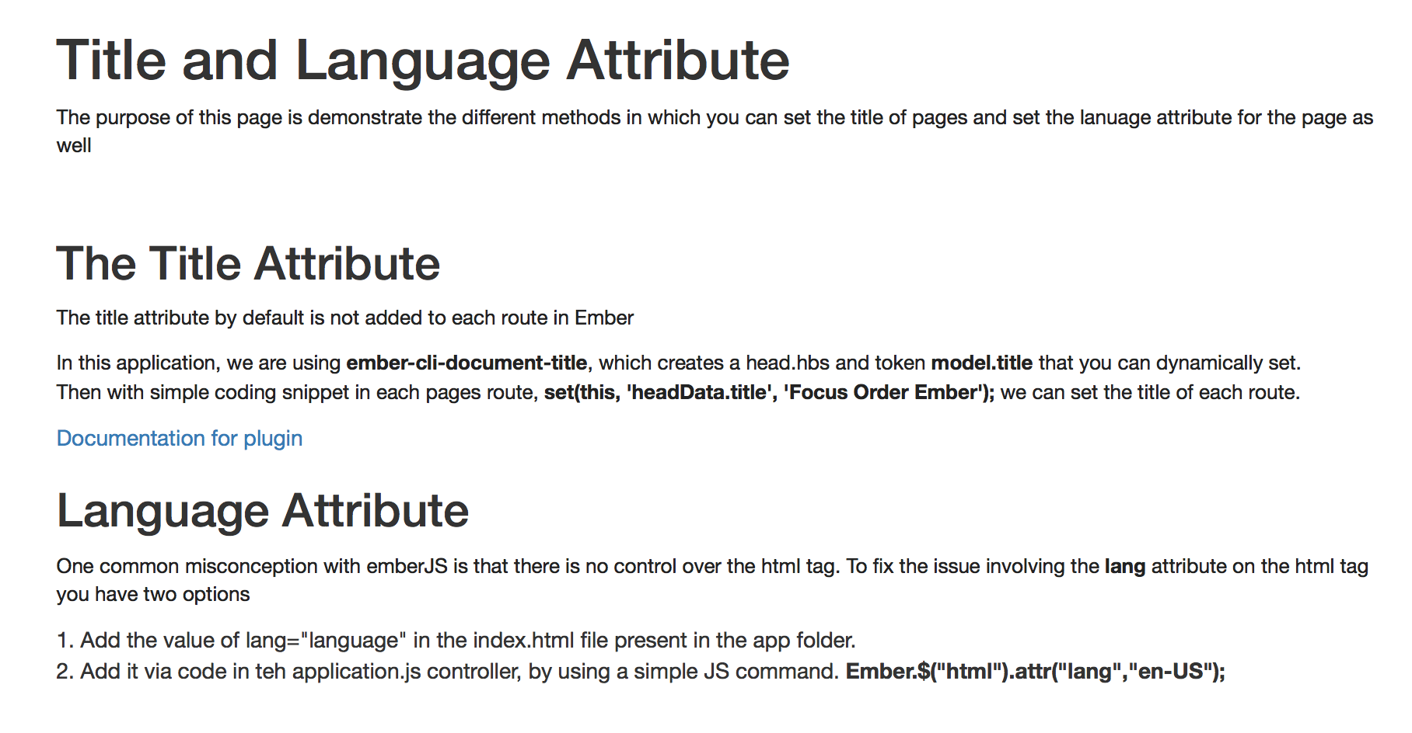
Title and Language Description

Slide 13
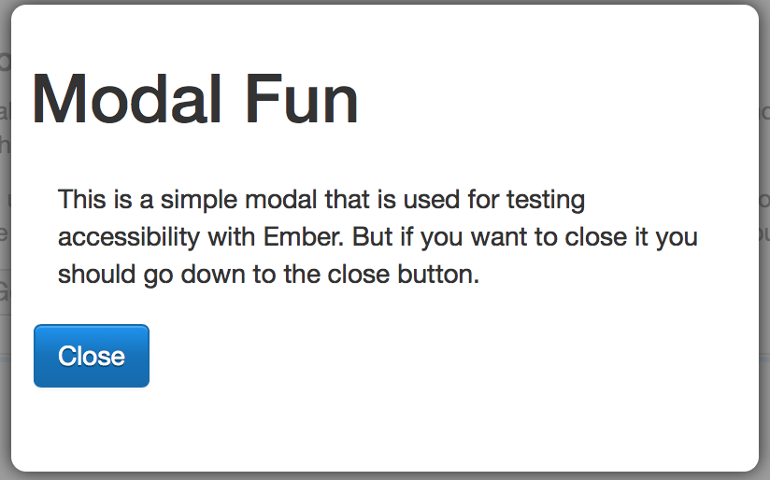
Modal Before

Slide 14
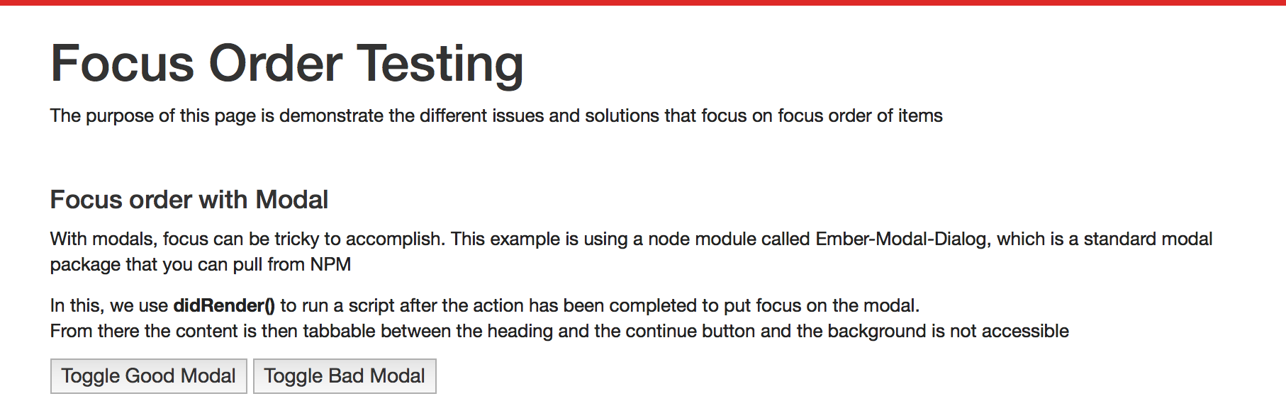
Modal Description

Slide 15
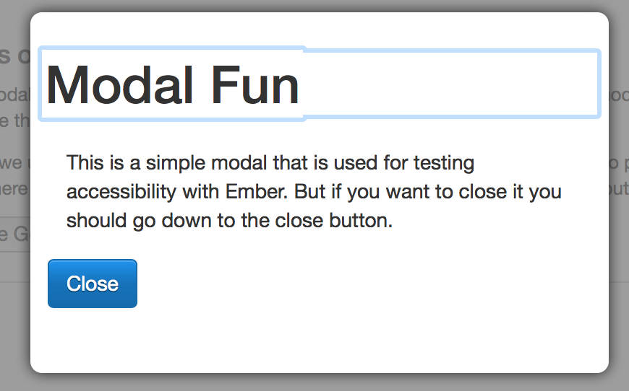
Modal After

Slide 16
Closing
Never underestimate the importance of being current on the JavaScript library versions (jQuery, Bootstrap, etc.)
As an organization, we continue to test, research and troubleshoot accessibility issues with single page applications
Notes:
Andy

Slide 17
Questions / Comments
Andy Nelson
Mark Steadman
CB Averitt
@dive4cb on Twitter
Notes:
All

